Slide 1
Lesson 10
Evacuating A Casualty Using a SKED
or Improvised Litter

Slide 2
TASK
Prepare and use a SKED® litter or improvised litter to evacuate a casualty
CONDITIONS
Given a simulated casualty, a SKED® litter or appropriate materials to make an improvised litter, and personnel to act as litter bearers
STANDARDS
Score a GO on the performance checklist

Slide 3
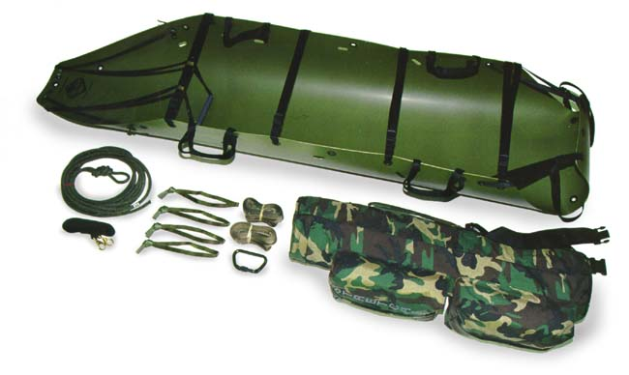
SKED® LITTER

Slide 4
PREPARE THE SKED®
Remove the SKED® litter from its pack and
place it on the ground
Unfasten the retainer strap
Step on the foot end of the SKED® litter and
unroll the SKED®
Bend the SKED® litter in half and back roll.
Repeat with the opposite end of the litter

Slide 5


Slide 6
TRANSPORT THE CASUALTY
Four-man litter team
Each bearer kneels at one of the handles with knee closest to the litter on the ground
Team leader positions himself at the handle nearest the casualty’s right shoulder (Gives all commands)
Upon command, bearers stand in unison, lifting the
casualty
Upon command, carry the casualty keeping him as level as possible

Slide 7
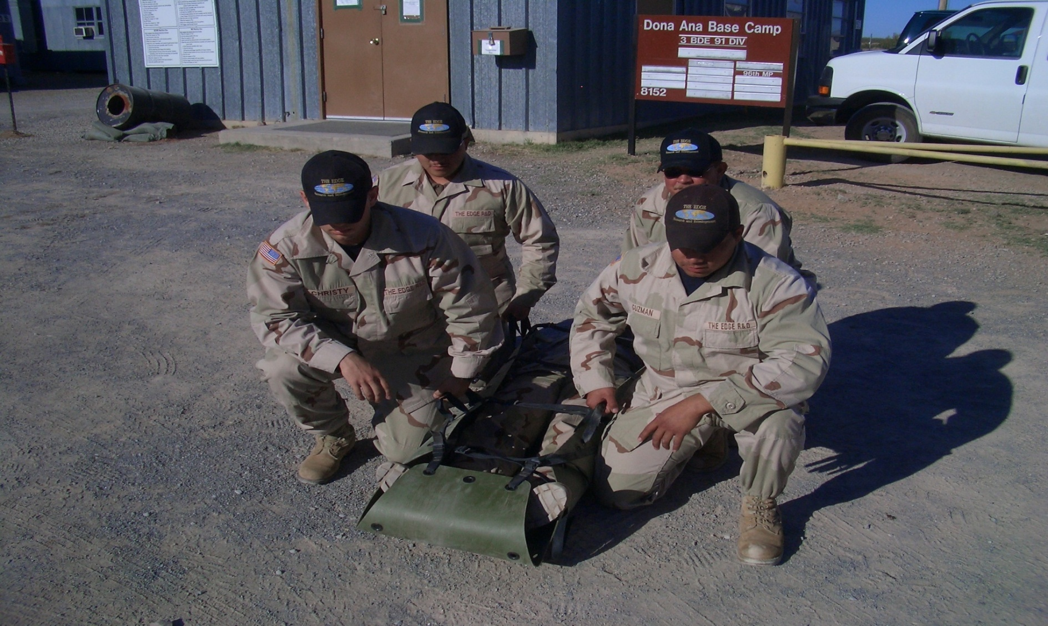
1
3
2
4

Slide 8
TRANSPORT THE CASUALTY
Two-man litter team
Position yourself on opposite sides of the
litter and face toward the casualty
Kneel on one knee and grab the two handles
nearest you
Upon command, rise in unison, lifting the
casualty

Slide 9
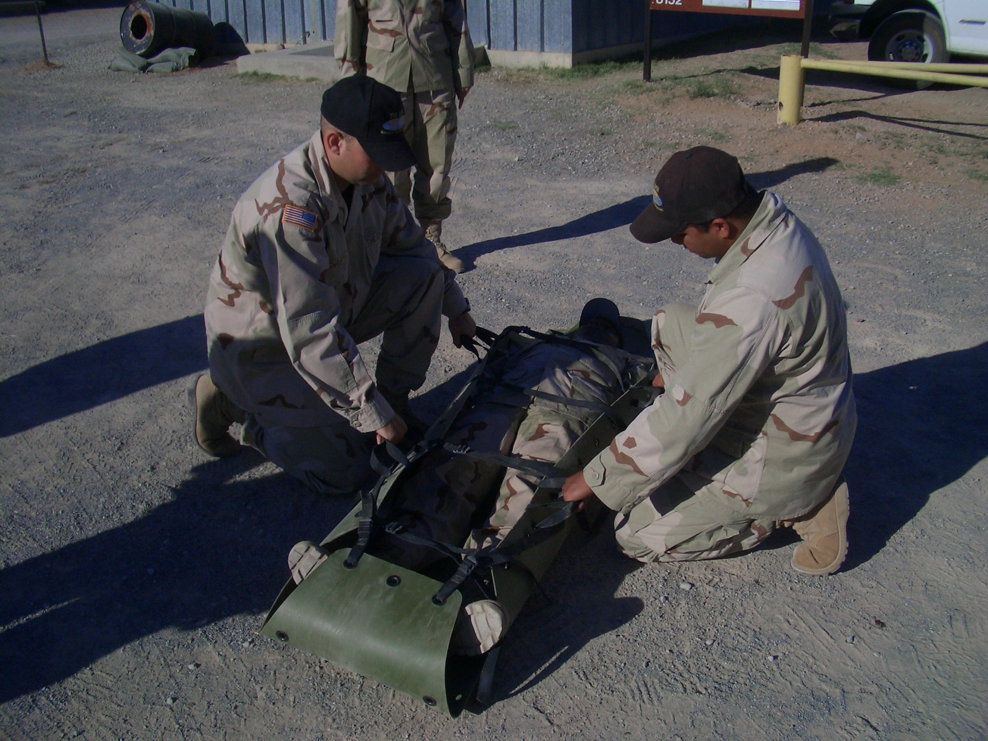

Slide 10
TRANSPORT THE CASUALTY
If no other person is available, use the
dragline at the head of the litter to drag the
casualty.

Slide 11
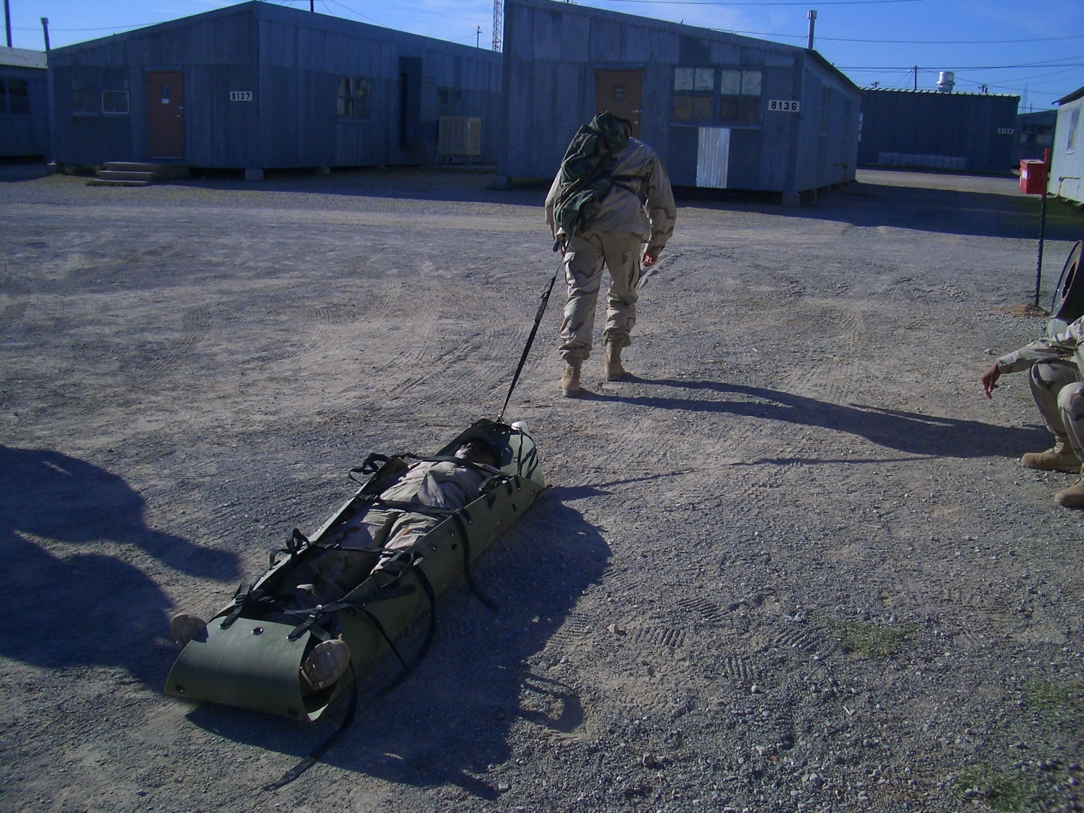

Slide 12
IMPROVISED LITTERS
Blanket and pole litter
Poncho and pole litter
Jacket and pole litter
Sack and pole litter
Blanket litter

Slide 13
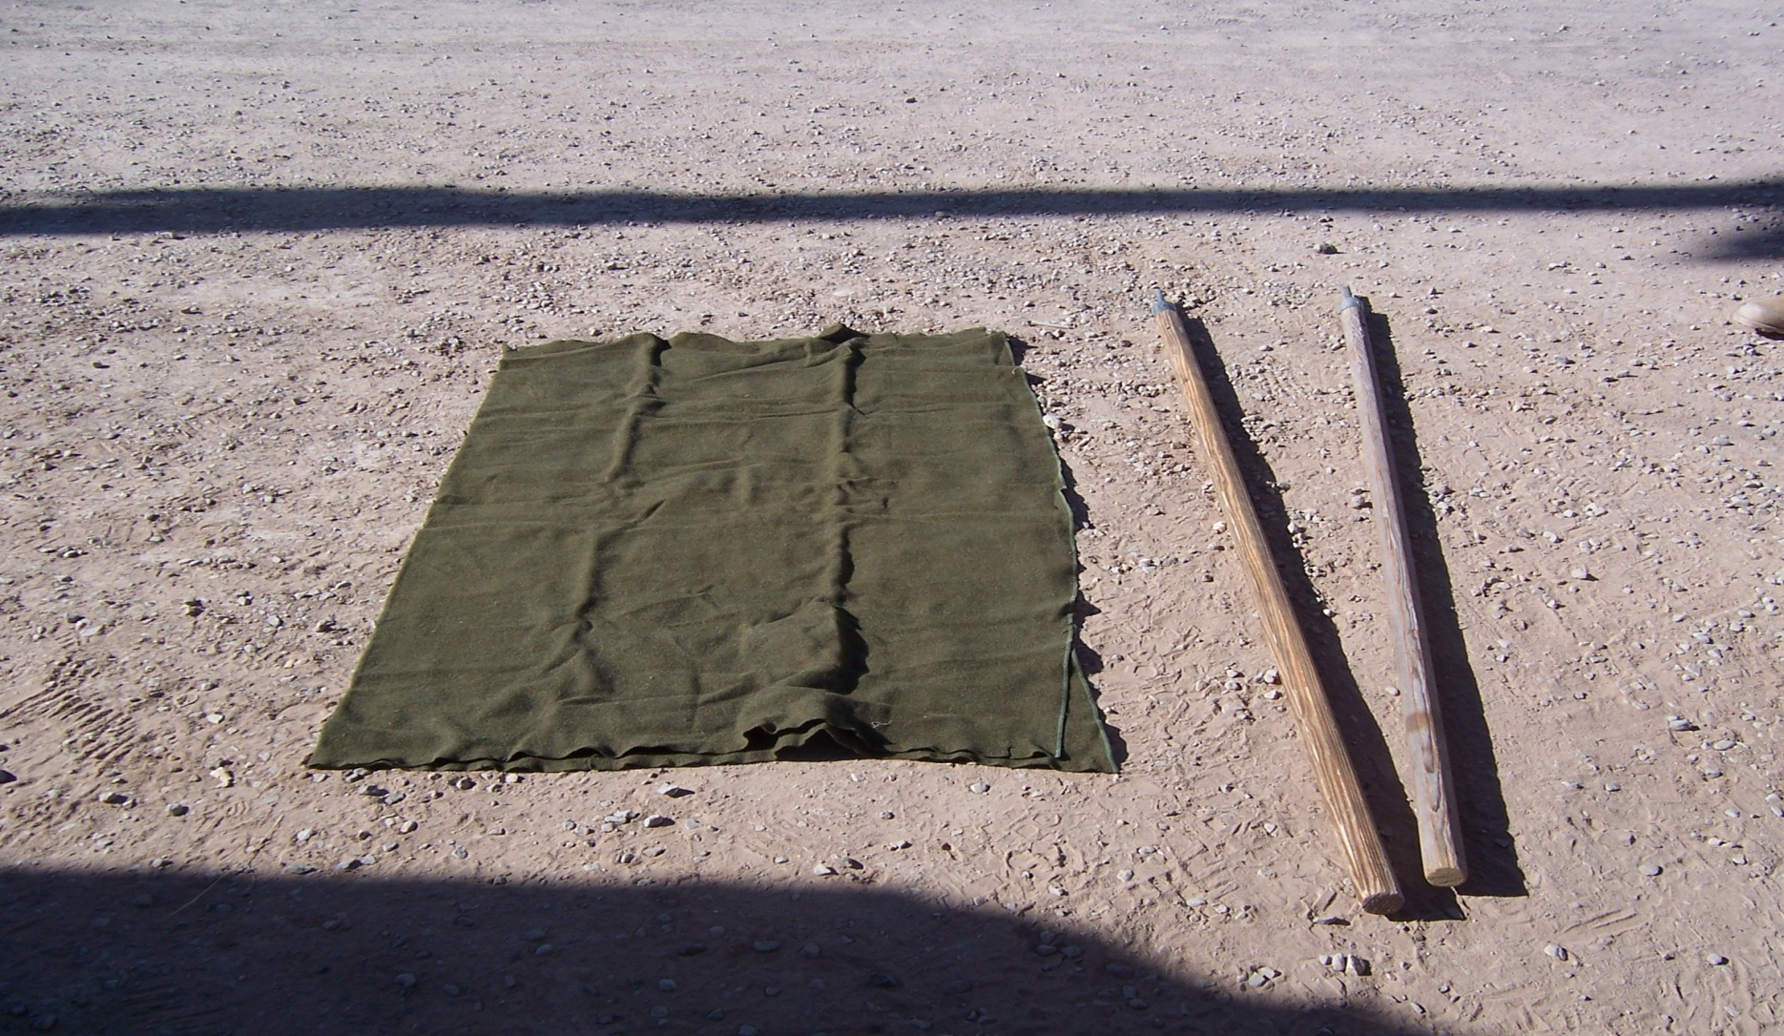
POLE AND BLANKET LITTER

Slide 14
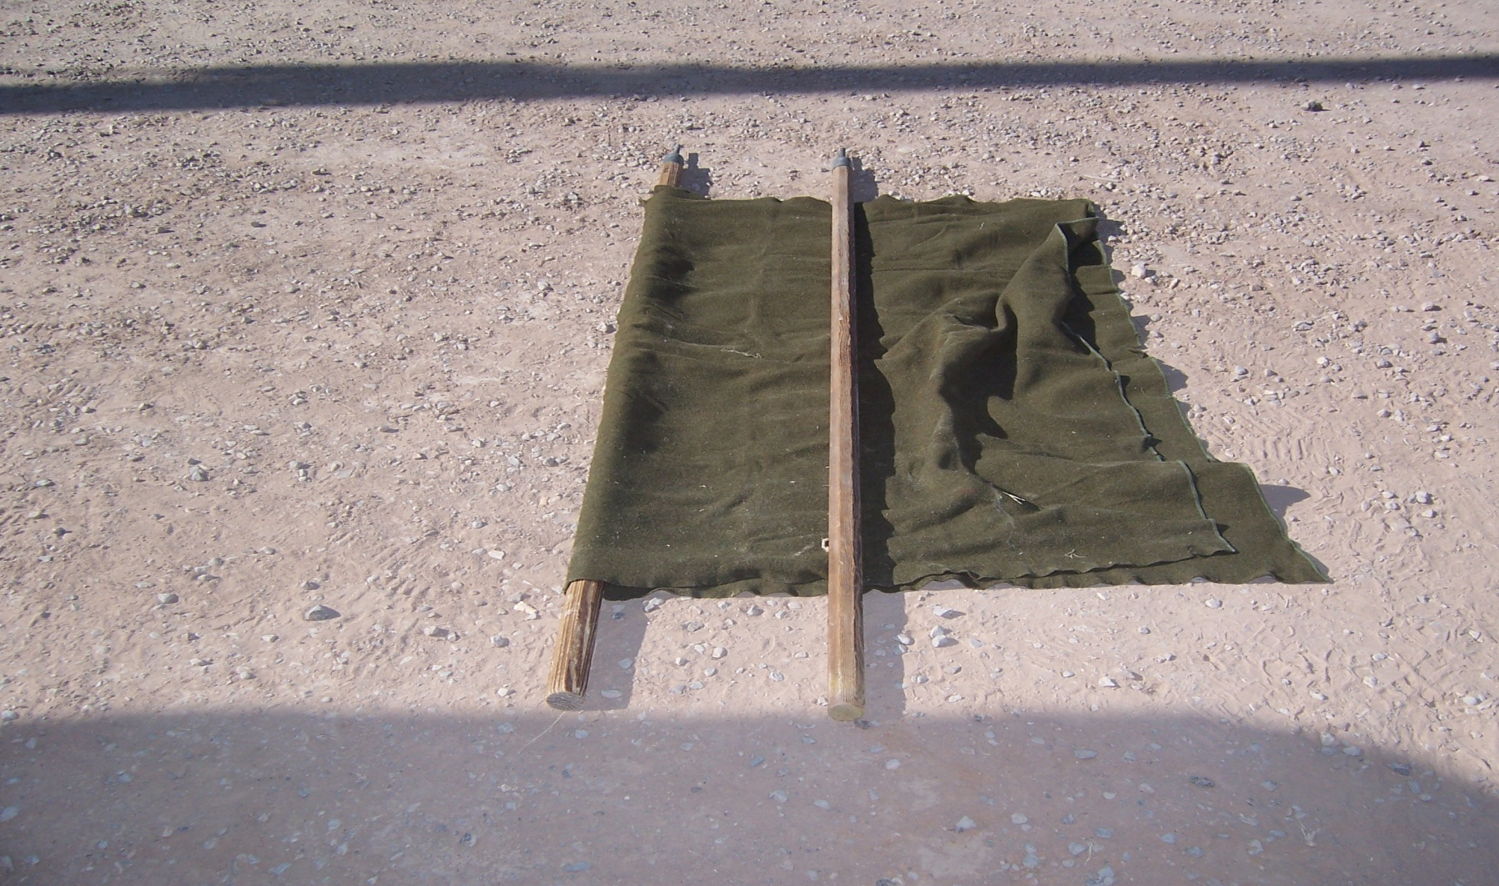
POLE AND BLANKET LITTER

Slide 15
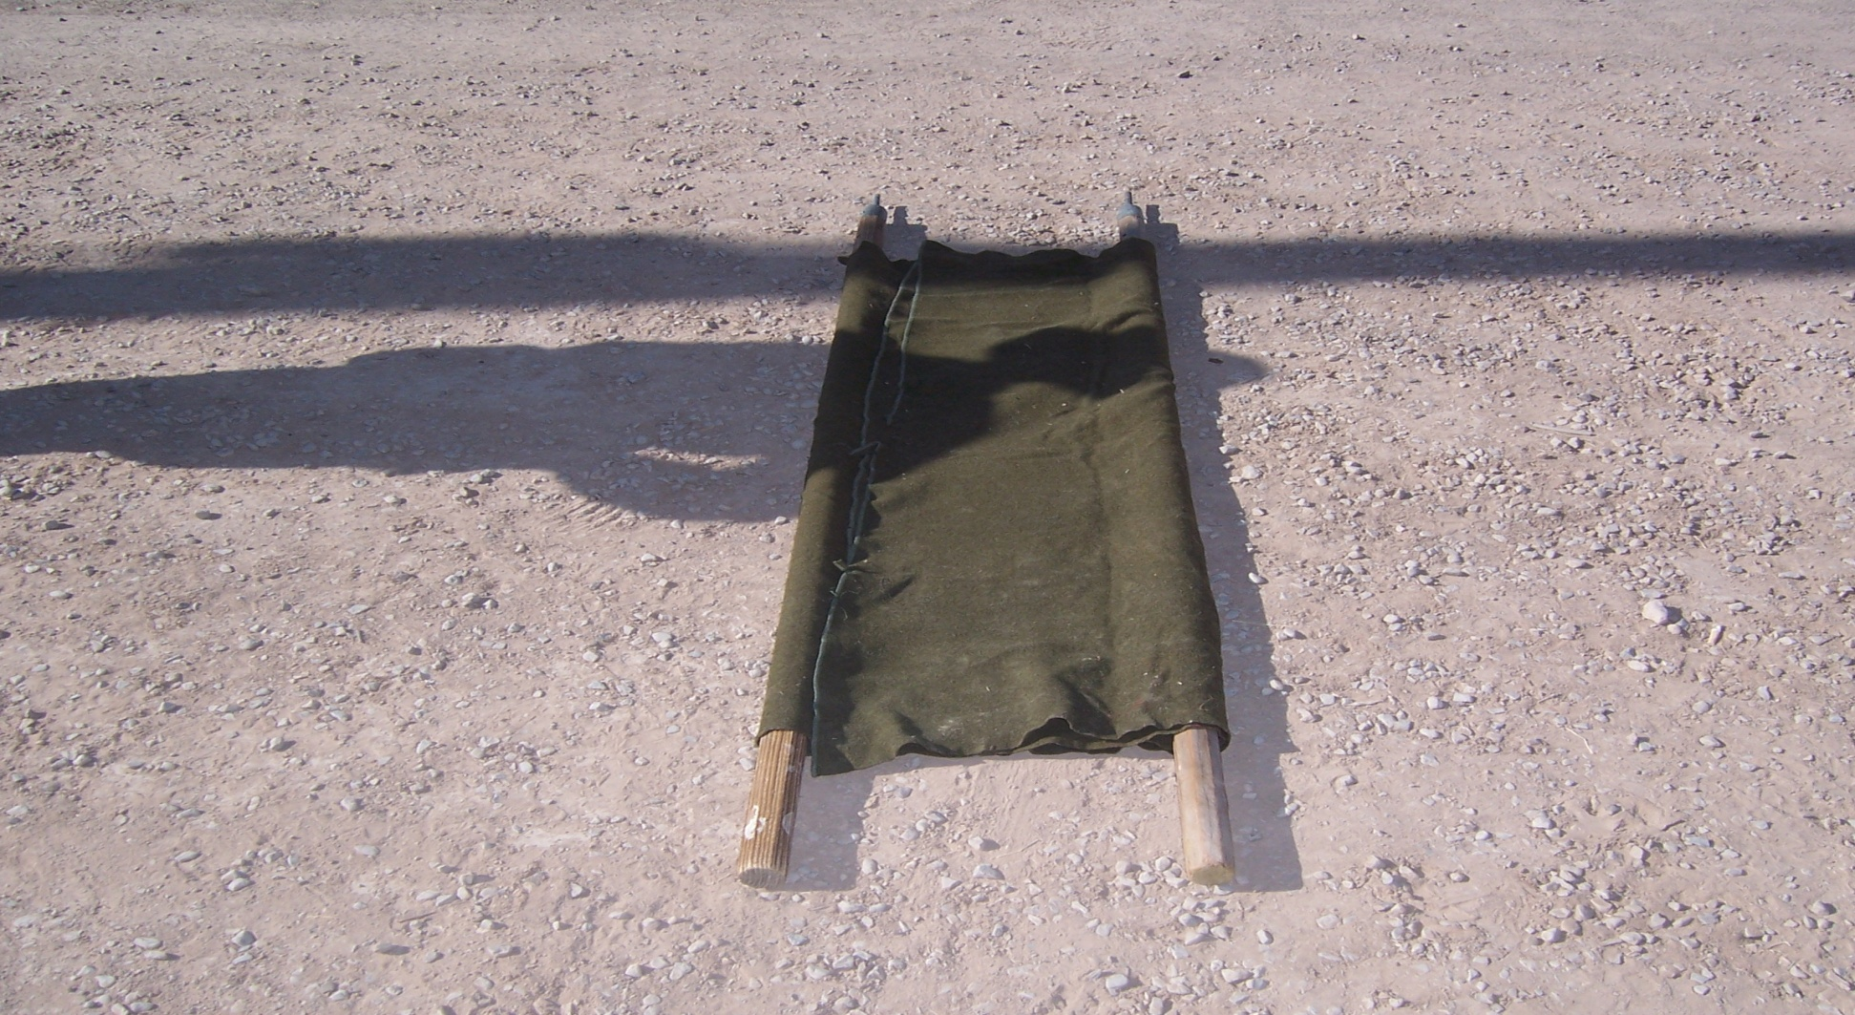
POLE AND BLANKET LITTER

Slide 16
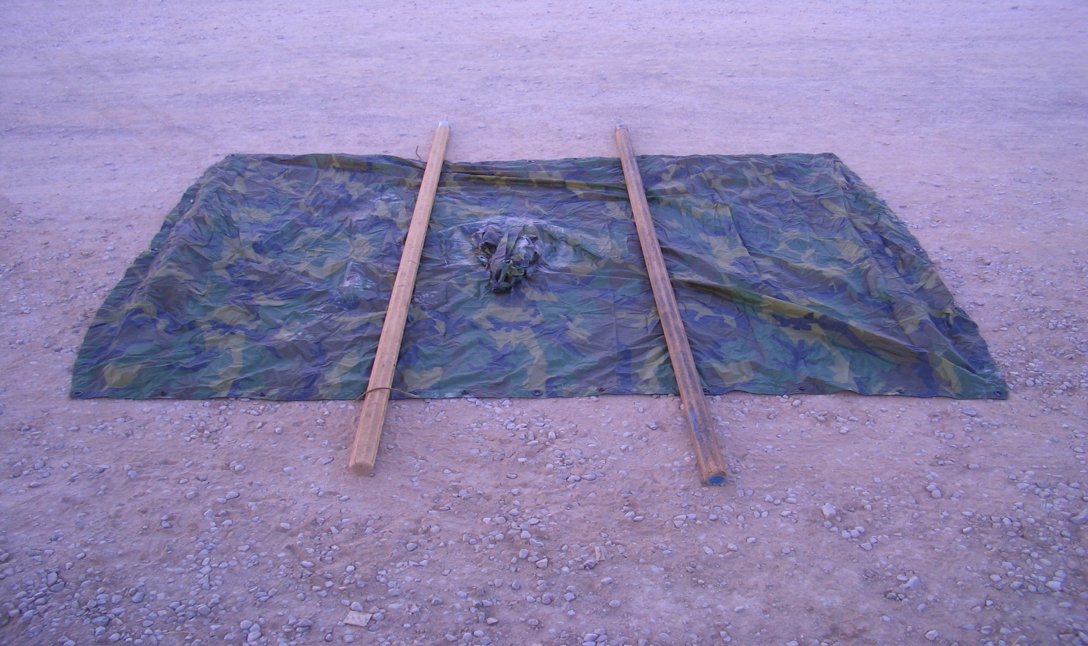
IMPROVISED POLE AND PONCHO LITTER

Slide 17
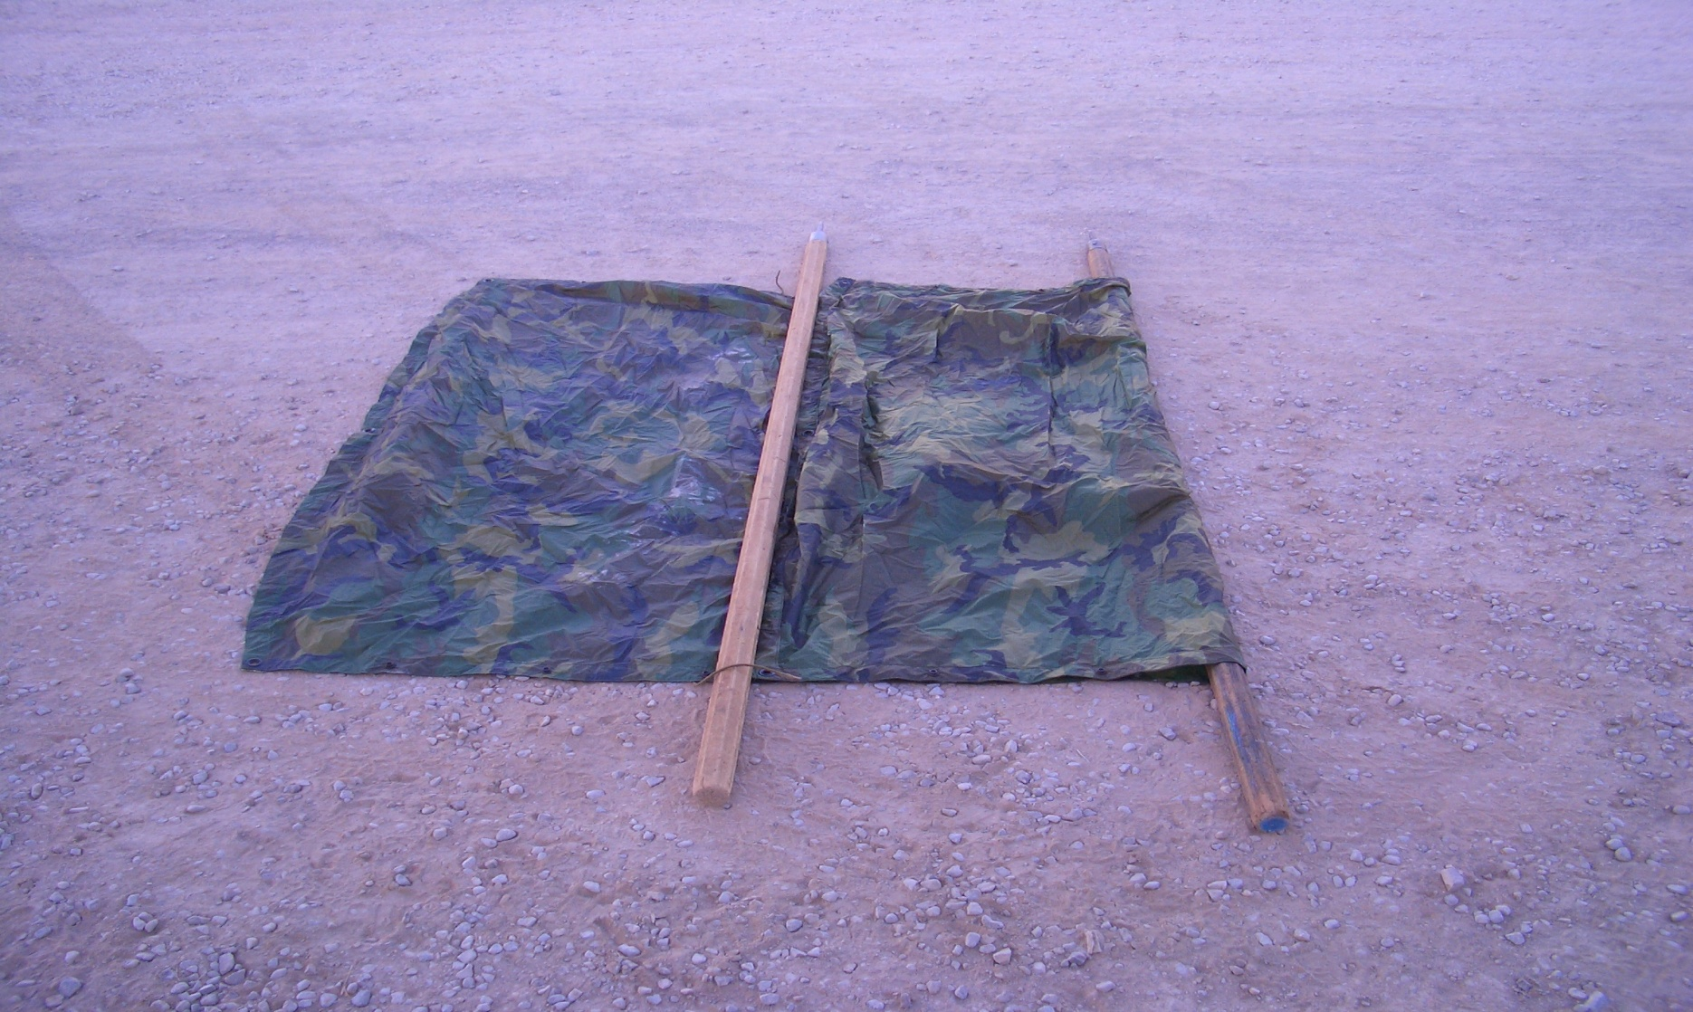
IMPROVISED POLE AND PONCHO LITTER

Slide 18
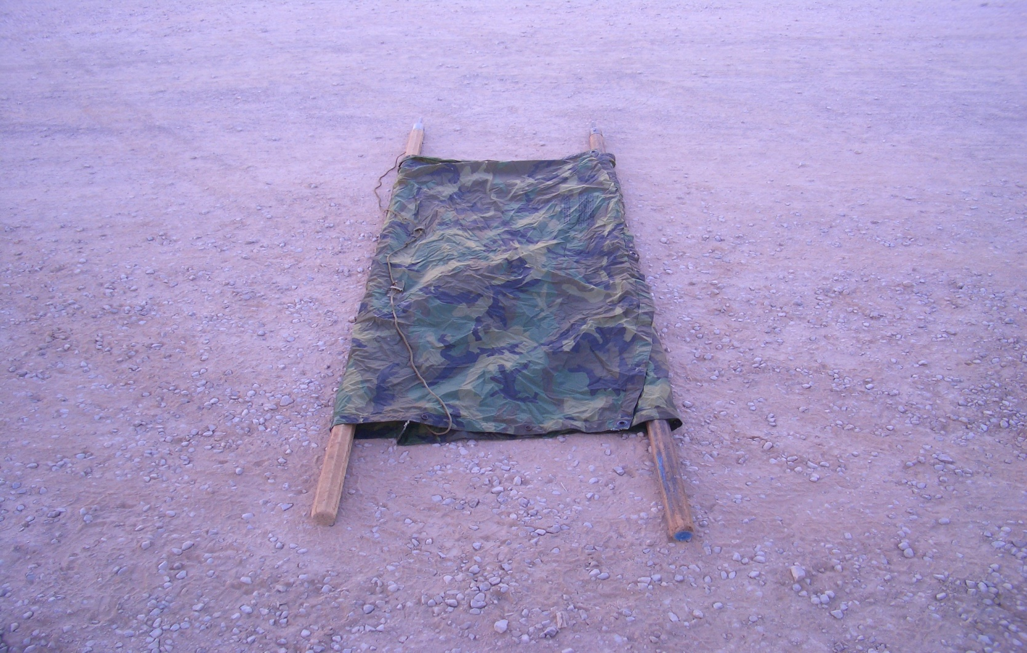
IMPROVISED POLE AND PONCHO LITTER

Slide 19
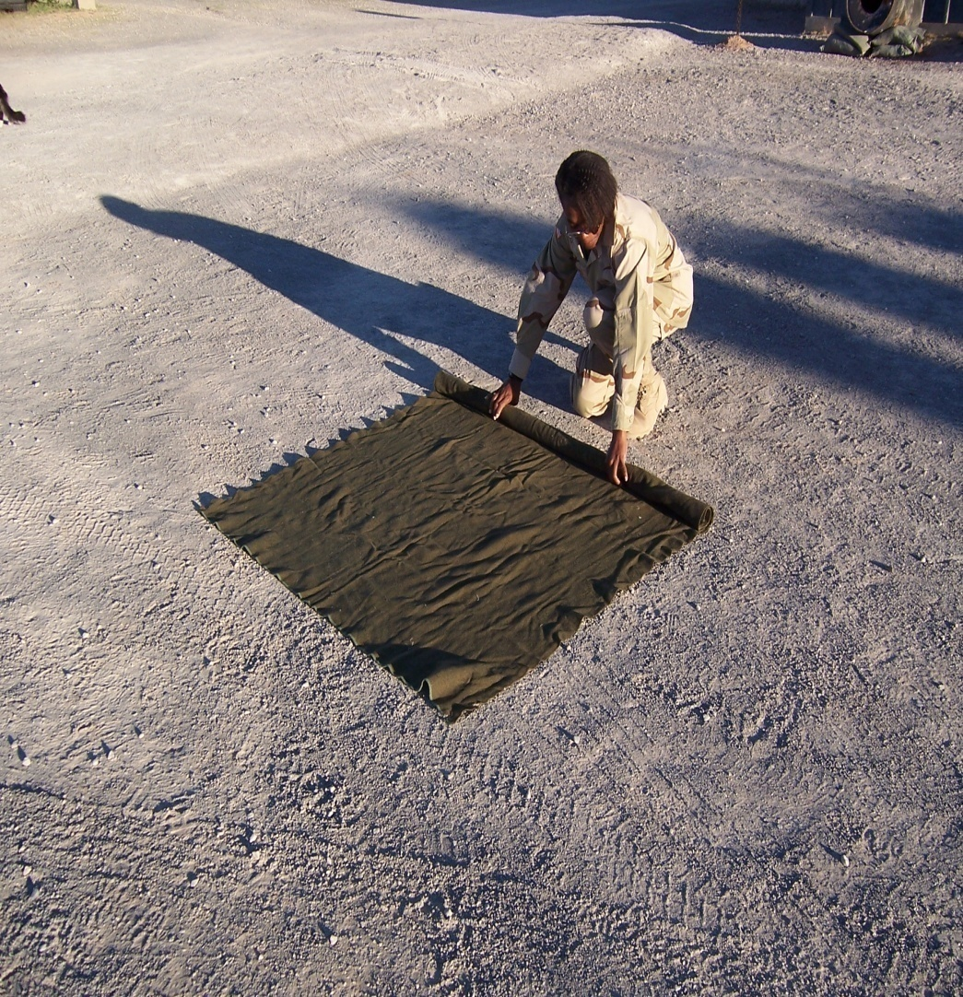
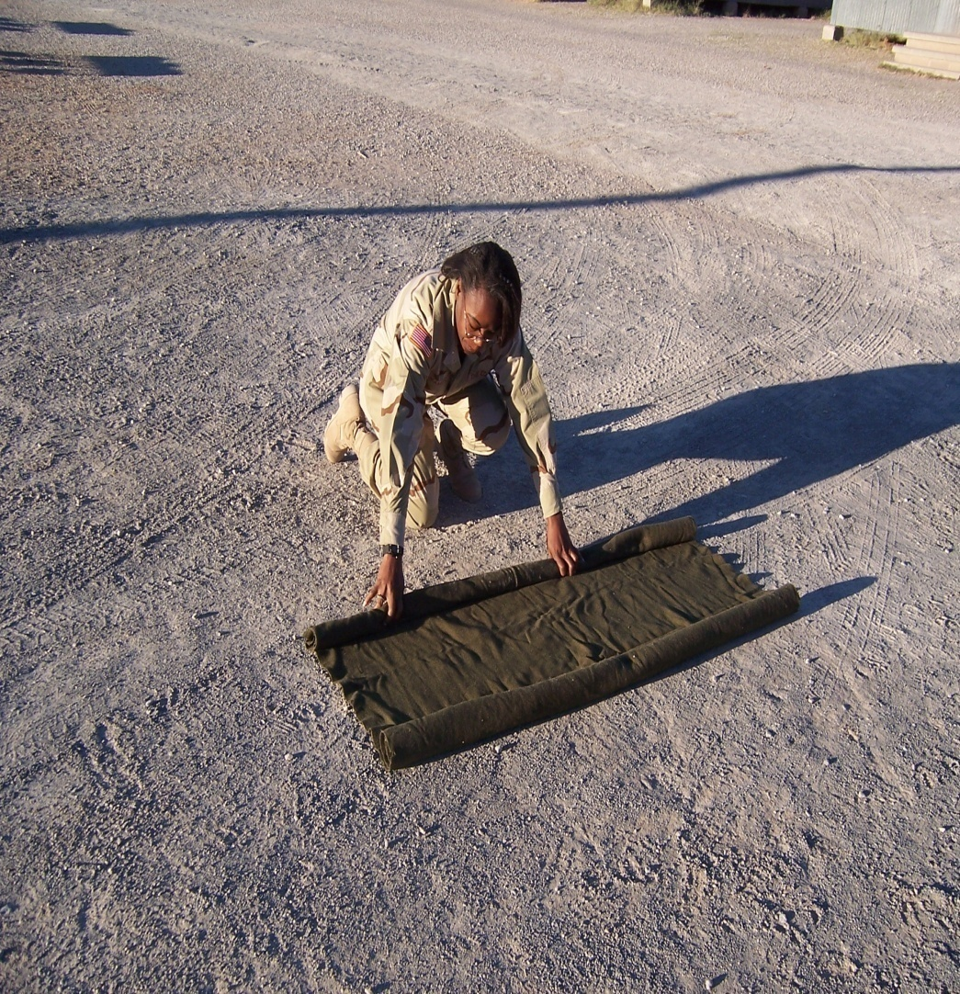
IMPROVISED BLANKET LITTER

Slide 20
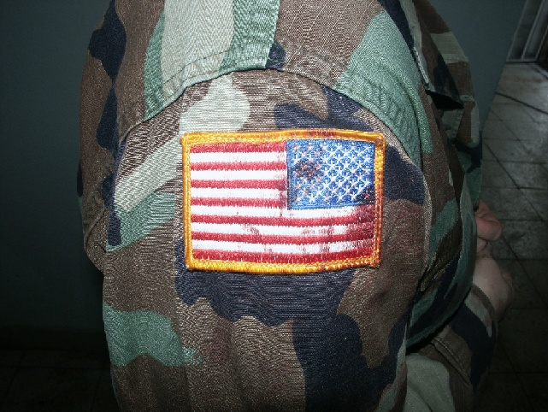
QUESTIONS?

